Slide 1
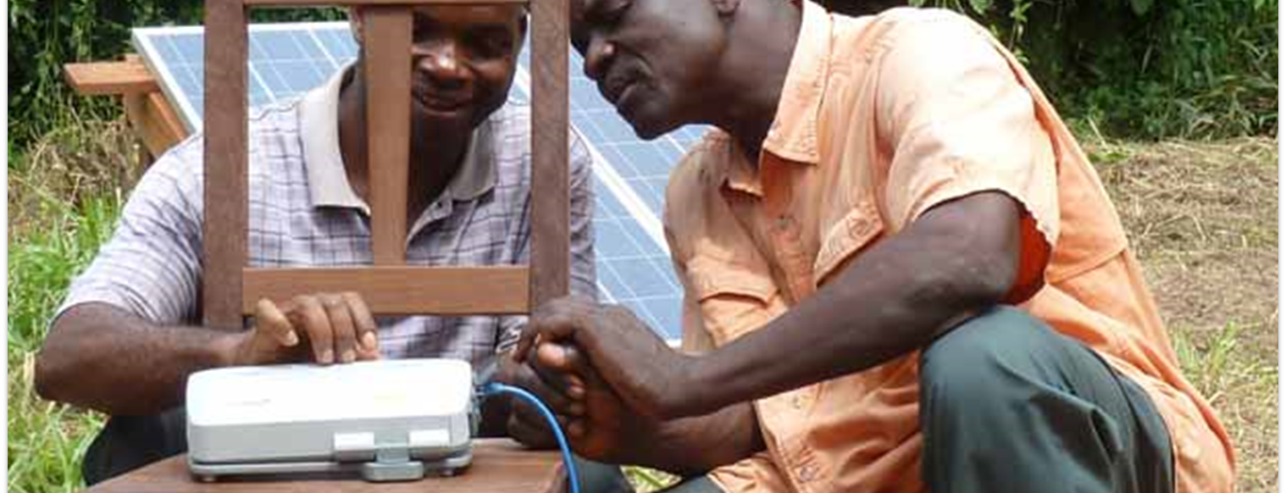
So [Joseph] gathered up all the food of the seven years which were in the land of Egypt, and laid up the food in the cities; he laid up in every city the food of the fields which surrounded them (Gen. 41:48).
All Scripture is taken from the New King James Version®. © 1982 by Thomas Nelson, Inc. Used by permission. All rights reserved.
Software Tools for Translating

Slide 2

Free
Software
Free
Resources
Free
Storage
and Use
on WACS

Slide 3
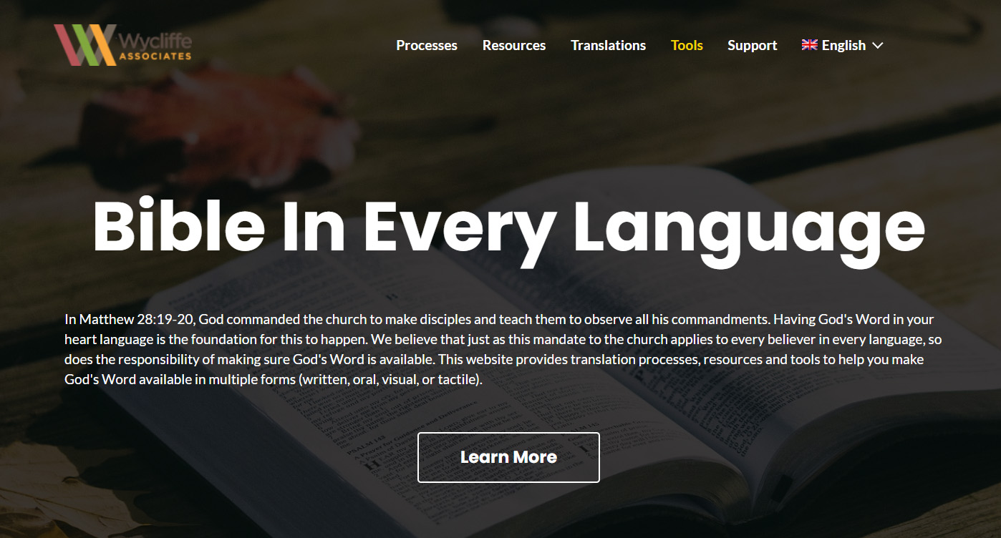
bibleineverylanguage.org

Slide 4



Translation Formats
writing system?
mp3 or smart phone?
?
Written
Oral
Local Church

Slide 5






Downloadable
1
2
Checking Resources Included!

Slide 6



Downloadable
Checking Resources Not Included

Slide 7

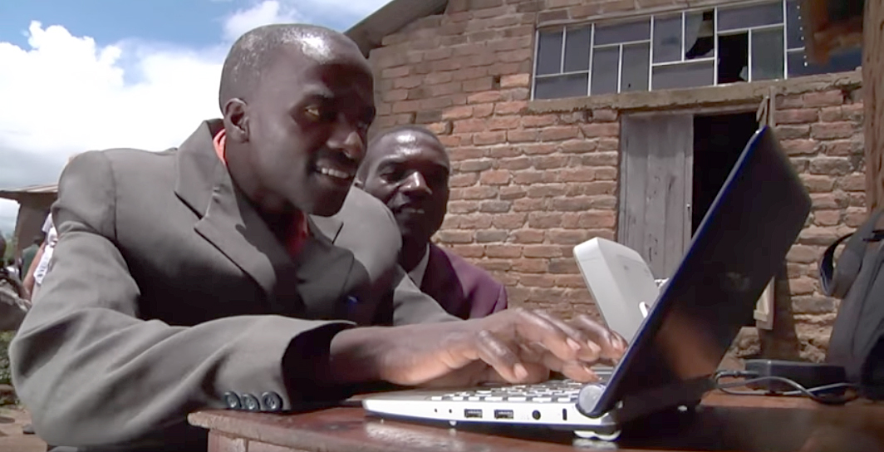

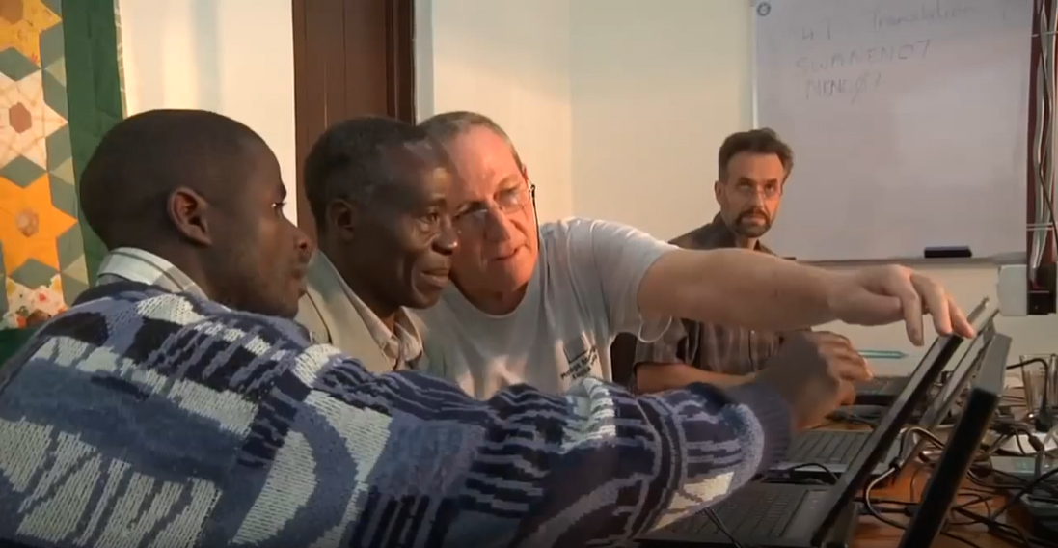
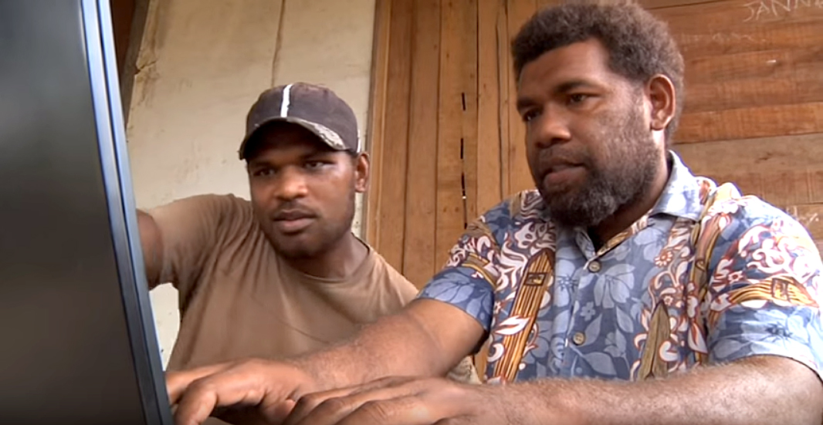
V-MAST Online Network
Checking Resources Available Online!

Slide 8
Free Technical Tools for Written Translations
Downloadable
Only one computer needed
Checking resources included
Downloadable
Simplest one to use
No checking resources included
All translators must work online
MAST steps built in
Checking resources included

Slide 9
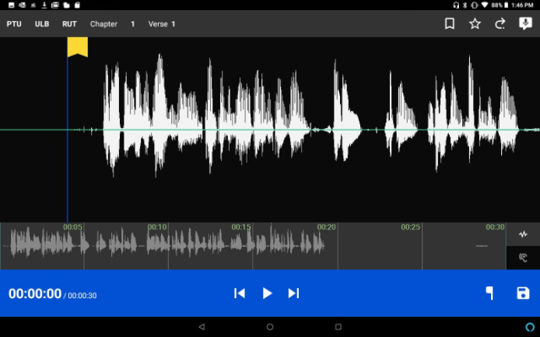

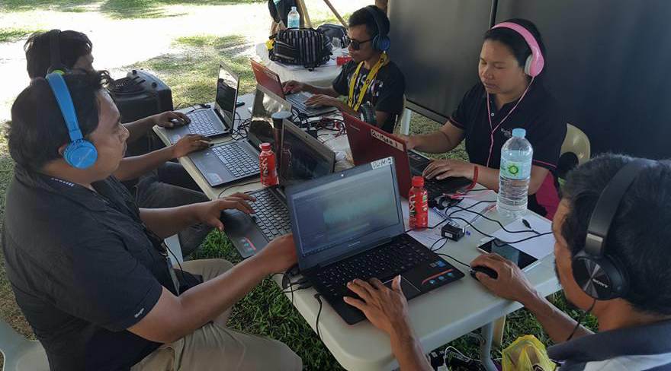

Slide 10

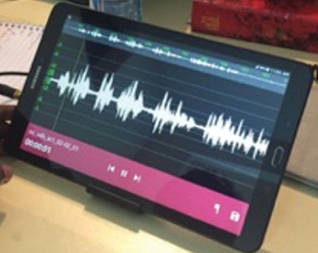
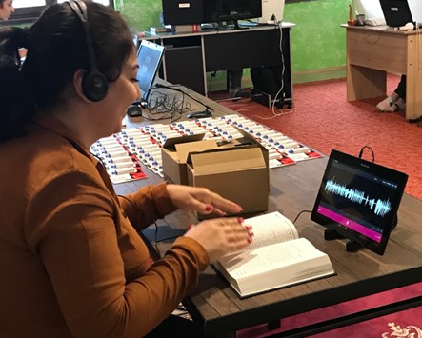
Orature

Slide 11
Free Technical Tools for Oral Translations
Simplest to use
Users must download audio source files
Can also be used for recording written translations
Audio source files are built in
Orature

Slide 12
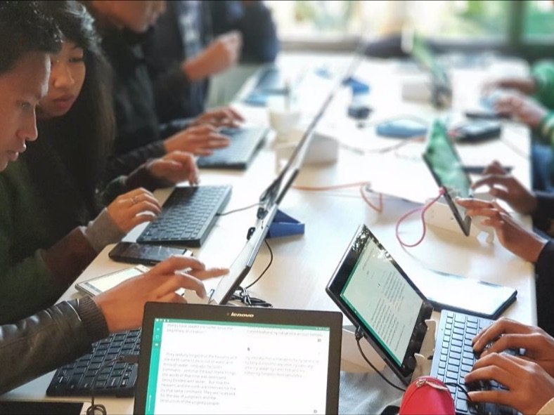
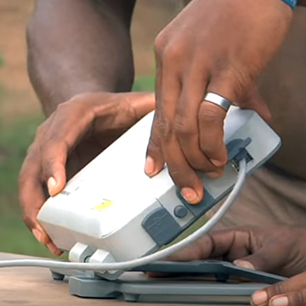
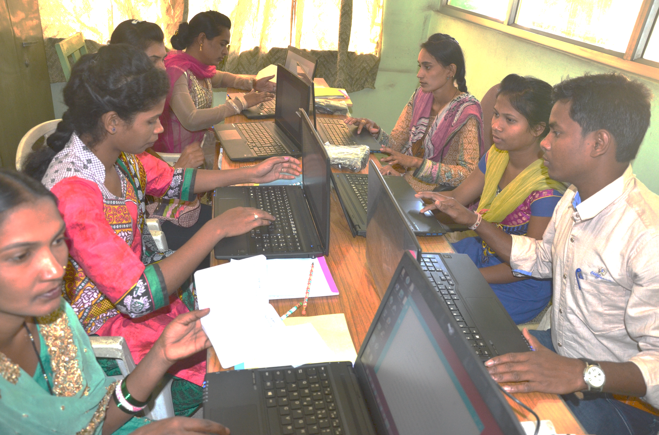
?
Consider:
Accessibility to laptops
Which tool works best?
Accessibility to good internet
Computer literacy of translators

Slide 13
Orature

Slide 14

?
Benefits?
Challenges?
Local Church

Slide 15
Psalm 102:18
This will be written for the generation to come, That a people yet to be created may praise the Lord.

